Slide 1
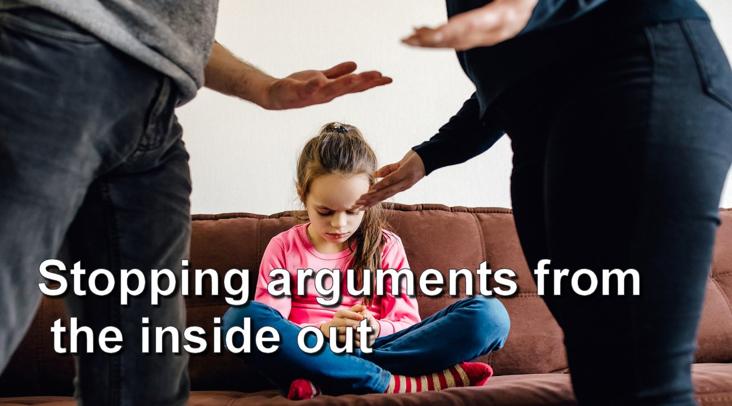
Stopping Arguments from the Inside Out
Ross Statham
Chipley church of Christ
September 11, 2022

Slide 2
Why?
This is not only practical, its Biblical
It’s needed by children, teenagers, and adults
It’s applicable to any relationship– couples, friends, churches, business, school, life

Slide 3
What happens?
Someone does or says something that you perceive to be wrong, OR
Someone comes to you or calls you regarding something that they perceive that YOU did or said that was wrong
It’s not a discussion– it becomes a confrontation. It’s gets heated. It gets ugly.

Slide 4
Matthew 5:9
“Blessed are the peacemakers, for they shall be called the sons of God”
Let’s talk about how you go to someone and talk about what they said or did
Let’s talk about how you cool down people who come and want to “have it out”

Slide 5
Sin or not, this is how we go to people:
In Matthew 15:18 and following, Jesus clearly spells out how to talk to someone you perceive is in sin.
No mention of telling others- that’s called gossip.
No mention of getting ugly or confrontational.
Purpose? Do win back your brother/sister. In love.
Calmly describe what you thought you heard or saw. Give them a chance to explain. Listen.
I like to do this by asking open-ended questions.

Slide 6
What happens if they get angry?
No one likes to be confronted with sin; not everyone has the maturity of David.
If they lose their cool, you don’t. Let them blow off steam. Listen calmly.
When they cool off, offer to talk more about it in a day or so. And do so.
If they won’t listen, take the additional steps.

Slide 7
If someone comes to you
They’re probably nervous about this and may get loud or emotional. You stay calm.
Don’t interrupt, even if they’re dead wrong!
Proverbs 15:1 “A soft answer turns away wrath”
Listen. You very well could be in the wrong.
Let them talk, and don’t interrupt. Nod. Focus.
Listen to their words, and ignore their anger.

Slide 8
Once they’re talked out…
Tell them what you heard them say, and ask for clarification “so that I fully understand.”
If you think it’s something that can be discussed calmly now, then do so.
If not, say the following: “You’ve given me a lot to think about. Can you give me a few days to think about this and get back with you?”

Slide 9
Remember our mission:
To serve God, and to serve others.
To help others get to heaven.

Slide 10
What about you?
If anger or arguments are a problem for you, it can be fixed- if you’ve a mind to.
Peacemakers shall be called children of God!
How can we help you?

